Slide 1


Comprehensive Plan & Zoning Code Update
Second Public Workshop
April 8th, 2026
Town of Van Buren, NY

Slide 2
Agenda
Project Overview: Team, Scope, Schedule
What is a Comprehensive Plan?
Previous Planning Efforts
Demographic Trends
Community Survey Summary
Workshop
Next Steps

Slide 3
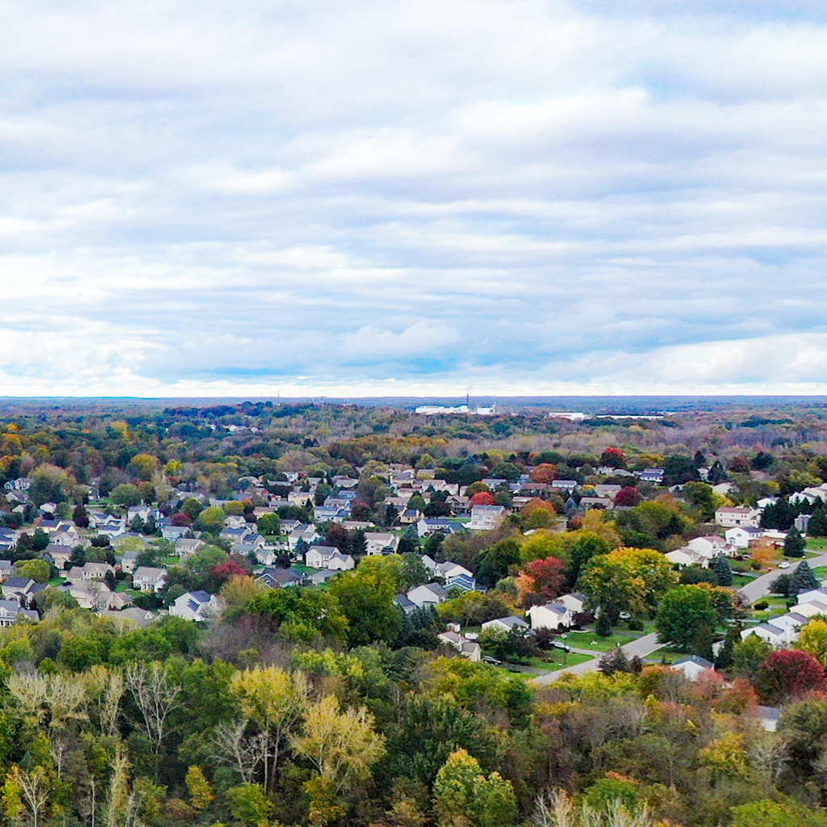
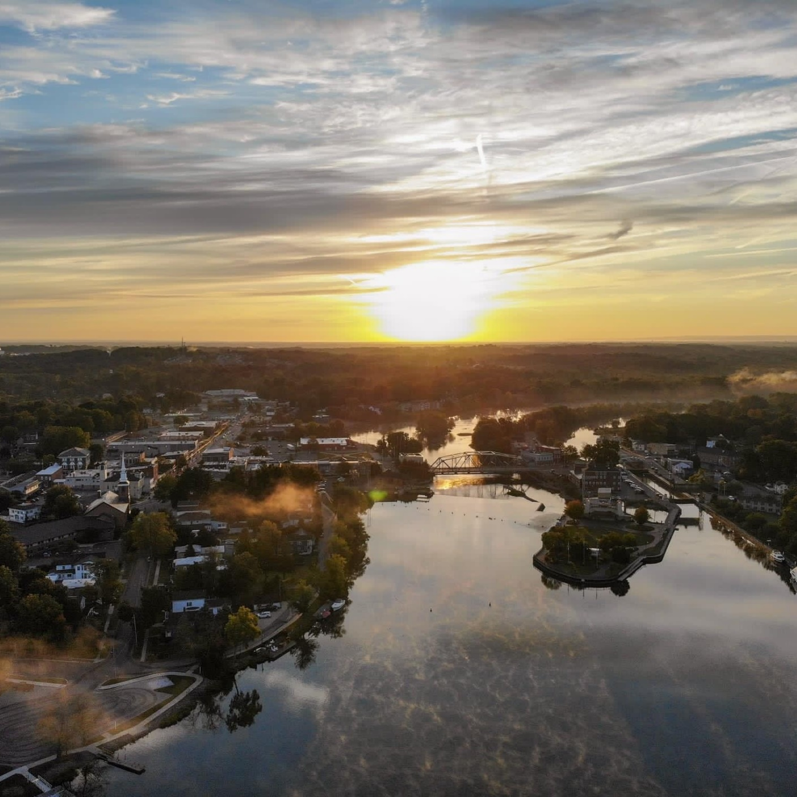
Project Overview
Project Team, Scope, Schedule

Slide 4



Project Team
Town of Van Buren
Robert Grover Chair / Town Council
Charles Gambino Deputy Codes Officer
Jason Hoy Town Engineer
Jesse McMahon Planning Board
Tim Morgan Resident
Janet Rasbeck Resident
Piels Scholten Resident
Chris Sherwood Resident
Jennifer Sullivan Town Council
Wendy Van Der Water Town Supervisor
Barton & Loguidice
Dan Theobald, AICP Project Manager
Silvi Patel Community Planner
Onondaga County
Megan Costa Urban Planner

Slide 5
Project Scope
Final Comprehensive Plan
Community Profile &
Previous Plans
Objectives and Actions
Draft Comprehensive Plan
Vision and Goal Framework
Meeting Summaries
Survey Summaries
Online Feedback Summaries

Slide 6
Project Schedule
We Are Here
Project kick-off
CPUC #2
CPUC #3
Workshop
CPUC
#4 & #5
2nd Workshop
Town Board Adoption
CPUC #6
April 2025
June
Sept
Oct
Jan / Feb 2026
April
May
June
Community Profile
&
Previous Plans
Launch Community Survey
Visioning Workshop
Vision & Goals
Public Workshop
Objectives & Actions
Public Hearing
SEQR
Public Hearing #2
Draft Objectives & Actions
County Review
Final Comp Plan

Slide 7
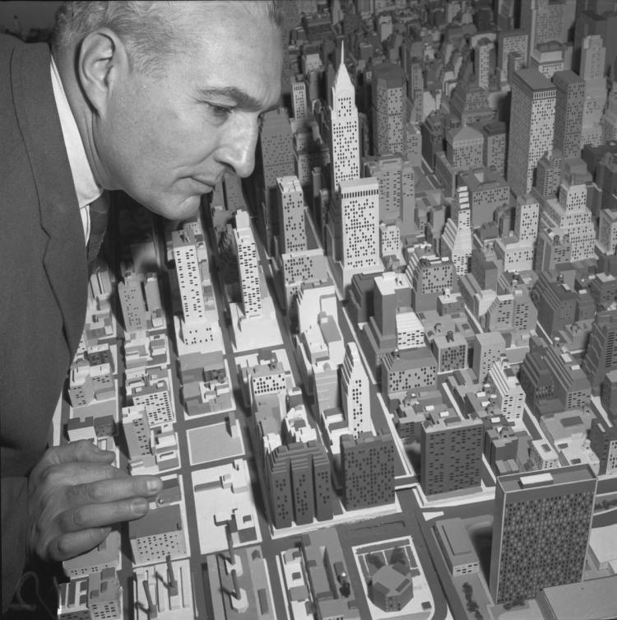
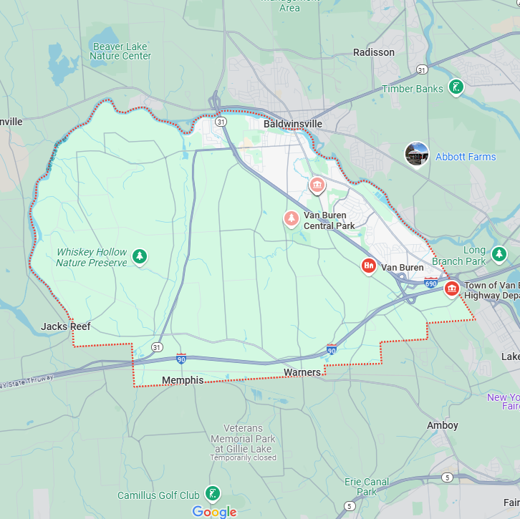
What is a Comprehensive Plan?

Slide 8
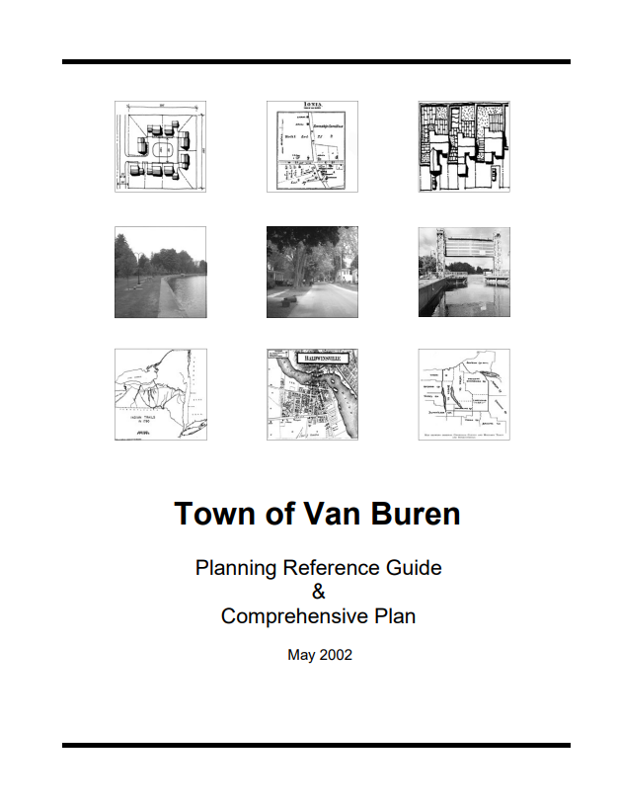
What is a Comprehensive Plan?
It is a Planning Document
Supported by NYS Law
Promotes the health, safety, and welfare of the public
Provides background information and policies to assist with decision-making
Establishes framework for future programs, development and investment

Slide 9
Benefits of a Comprehensive Plan
Establishes Town priorities
Directs decision-makers
Strengthens Town’s legal position
Increases chances of funding
Streamlines government procedures
Fosters economic development
Encourages discussion

Slide 10
Parts of a Comprehensive Plan
Introduction & Community Profile
Community Vision & Goals
Implementation Strategy
Objectives & Projects

Slide 11

Previous Planning Efforts

Slide 12

Plan Onondaga
County Comprehensive Plan adopted 2023
Focuses on 5 key themes:
  Strong Centers
  Housing & Neighborhoods
  Community Mobility
  Greenways & Blueways
  Agriculture

Slide 13
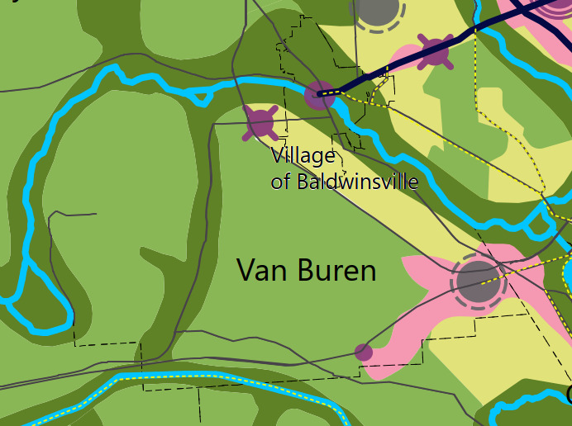





Plan Onondaga – Future Land Use Map
Strong Centers
Downer Street
State Route 690 intersection with Route 90
Legend
Notes:
Strong Centers
Strong centers are walkable, people oriented places with a mix of jobs, housing, shopping, dining, culture, public spaces, entertainment, transportation, and services.

Slide 14
Plan Onondaga – Future Land Use Map
Greenways and Blueways
Seneca River
Old Erie Canal / Empire State Multi-Use Trail
Legend

Slide 15
2002 Van Buren Comp Plan
Major Town Goal & General Land Use Goals
Goal Categories:
  Agricultural and Open Space
  Residential Areas
  Commercial Areas
  Industrial / Employment Center Uses
  Transportation

Slide 16
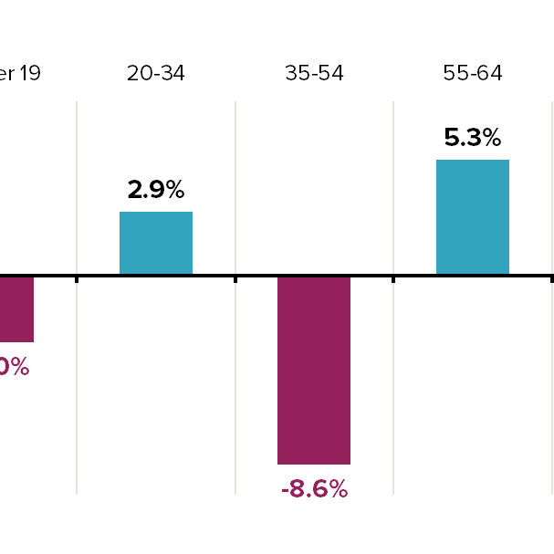
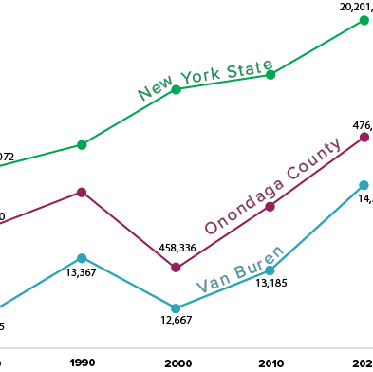
Demographic Trends

Slide 17
Population
+4%
+6%
+13%

Slide 18
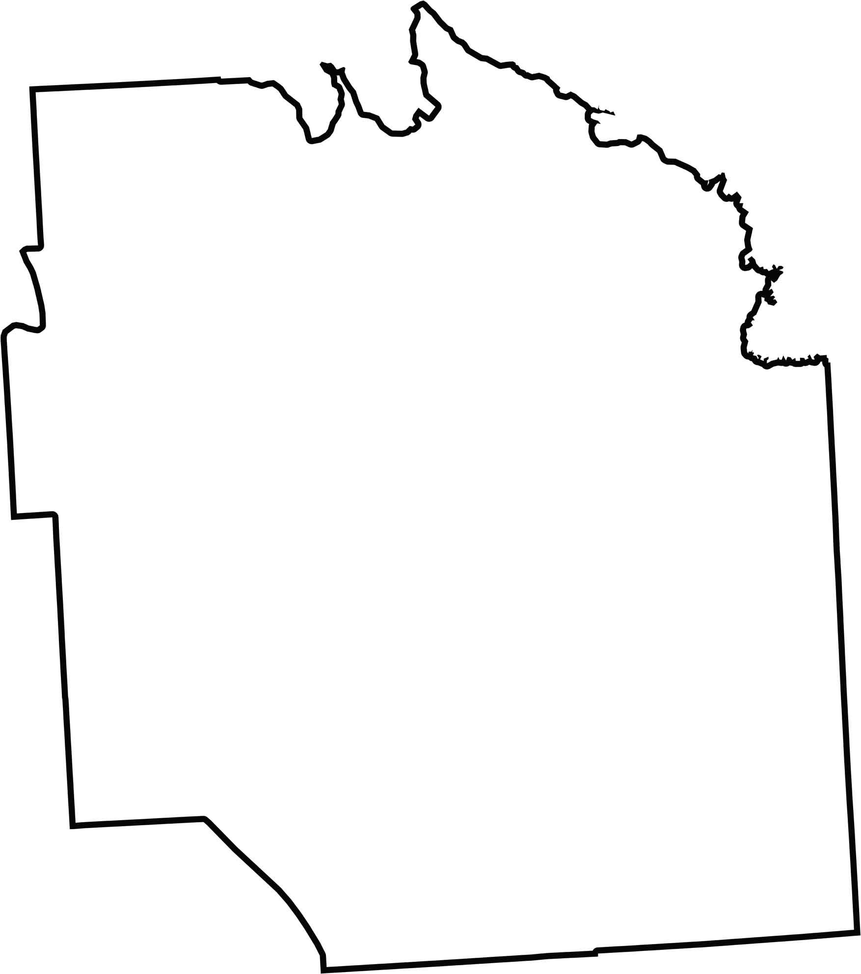
Population
Total Population, 2020
Population Change, 2010-2020
Clay | 60,527
Manlius | 33,712
Salina | 33,223
Cicero | 31,435
DeWitt | 26,074
Camillus | 25,346
Lysander | 23,074
Onondaga | 22,937
Geddes | 17,088
Van Buren | 14,367
Skaneateles | 7,112
Pompey | 7,080
Marcellus | 6,066
Elbridge | 5,476
LaFayette | 4,910
Tully | 2,676
Otisco | 2,368
Fabius | 2,006
Spafford | 1,588
Van Buren | 9.0%
Lysander | 6.0%
Camillus | 4.9%
Manlius | 4.1%
Clay | 4.0%
Fabius | 2.1%
DeWitt | 0.9%
Pompey | 0.0%
Geddes | 0.0%
Cicero | -0.6%
LaFayette | -0.9%
Skaneateles | -1.4%
Salina | -1.4%
Tully | -2.3%
Marcellus | -2.3%
Spafford | -5.8%
Otisco | -6.8%
Onondaga | -7.1%
Elbridge | -7.5%
Onondaga County

Slide 19
Housing
2010 2020
Total Housing 6,099 units 6,728 units +629
Vacant Housing 362 units (5.9%) 336 units (5%) -26
Occupied Housing 5,737 units 6,392 units +655
*Decennial Data
*American Community Survey
2010 2023
Single-family 3,755 4,182
Multi-unit 1,883 2,113
Mobile Homes 116 167
+427
+230
+51
708

Slide 20
Age
*2023 American Community Survey
65+
Under 19
55 - 64
20 - 34
Change in Age Distribution 2010 - 2023
35 - 54

Slide 21


Economic
Median Household Income
2023
$71,125
$74,704
$82,095
2010
Van Buren $47,762
Onondaga County $50,426
New York State $54,148
+49%
+48%
+52%
*2010 / 2023 American Community Survey
Median Household Income

Slide 22
Economic
Unemployment 2010-2023
Van Buren 2.2% (-4%)
Onondaga County 5.2% (-3%)
New York State 3.1% (3%)
Poverty Rate
8.6%
13.8%
14.2%
*2023 American Community Survey
Median Household Income

Slide 23

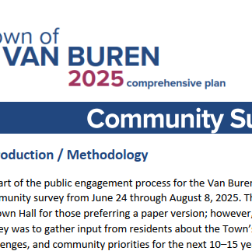
Community Survey Review
Review

Slide 24
Community Survey Overview
Open from June 24 through August 8, 2025
163 Responses
Strengths (what residents value now):
Strong sense of community and small-town feel
Safe environment and low crime rates
Family-friendly character, good place to raise children
Access to natural resources like the Seneca River, farmland, open space, and parks
Proximity to highways
Weaknesses (current concerns/issues):
Traffic congestion, especially at village “four corners” and Downer Street / Syracuse Street
Limited sidewalk and pedestrian connectivity
Lack of brush pickup / large item pickup
Strain on infrastructure (roads, sewers, stormwater) in certain neighborhoods
Notes:
Weakness related to limited municipal services: residents feel they pay similar or higher taxes but receive fewer core services

Slide 25
Community Survey Overview
Threats (risks if issues aren’t addressed):
Overdevelopment leading to loss of rural character and farmland
Increasing traffic and safety concerns with new housing growth
Strain on schools and public services from rapid population growth
Opportunities (future directions to pursue):
Protecting farmland and open space from overdevelopment
Expanding parks, trails, and recreational opportunities
Enhancing public waterfront access
Supporting housing and senior living options
Attracting more local businesses, restaurants, and services to fill gaps (e.g., dining, grocery, medical, senior programs)
Building on the small-town identity with more community events and festivals

Slide 26
Vision Statement
The Town of Van Buren is a welcoming, family-friendly community that blends rural character, natural beauty, and small-town charm. Residents value its safe neighborhoods, schools, and access to parks, trails, and the Seneca River. Van Buren is committed to preserving its farmland and open spaces while guiding new growth to areas with existing infrastructure, ensuring balanced, sustainable development. It is a place for every generation, where people can put down roots, raise families, enjoy recreation, and remain connected throughout all stages of life.

Slide 27
Goal Areas
Goal 1: Agriculture, Farmland, and Open Space
Goal 2: Neighborhoods
Goal 3: Economic Development and Local Business
Goal 4: Transportation and Mobility
Goal 5: Parks, Recreation, and Waterfront Access
Goal 6: Infrastructure and Public Services
Goal 7: Community Character and Quality of Life
Goal 8: Natural Environment

Slide 28
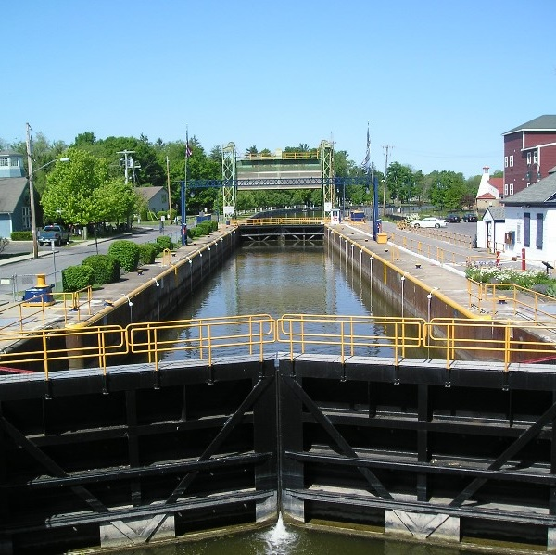
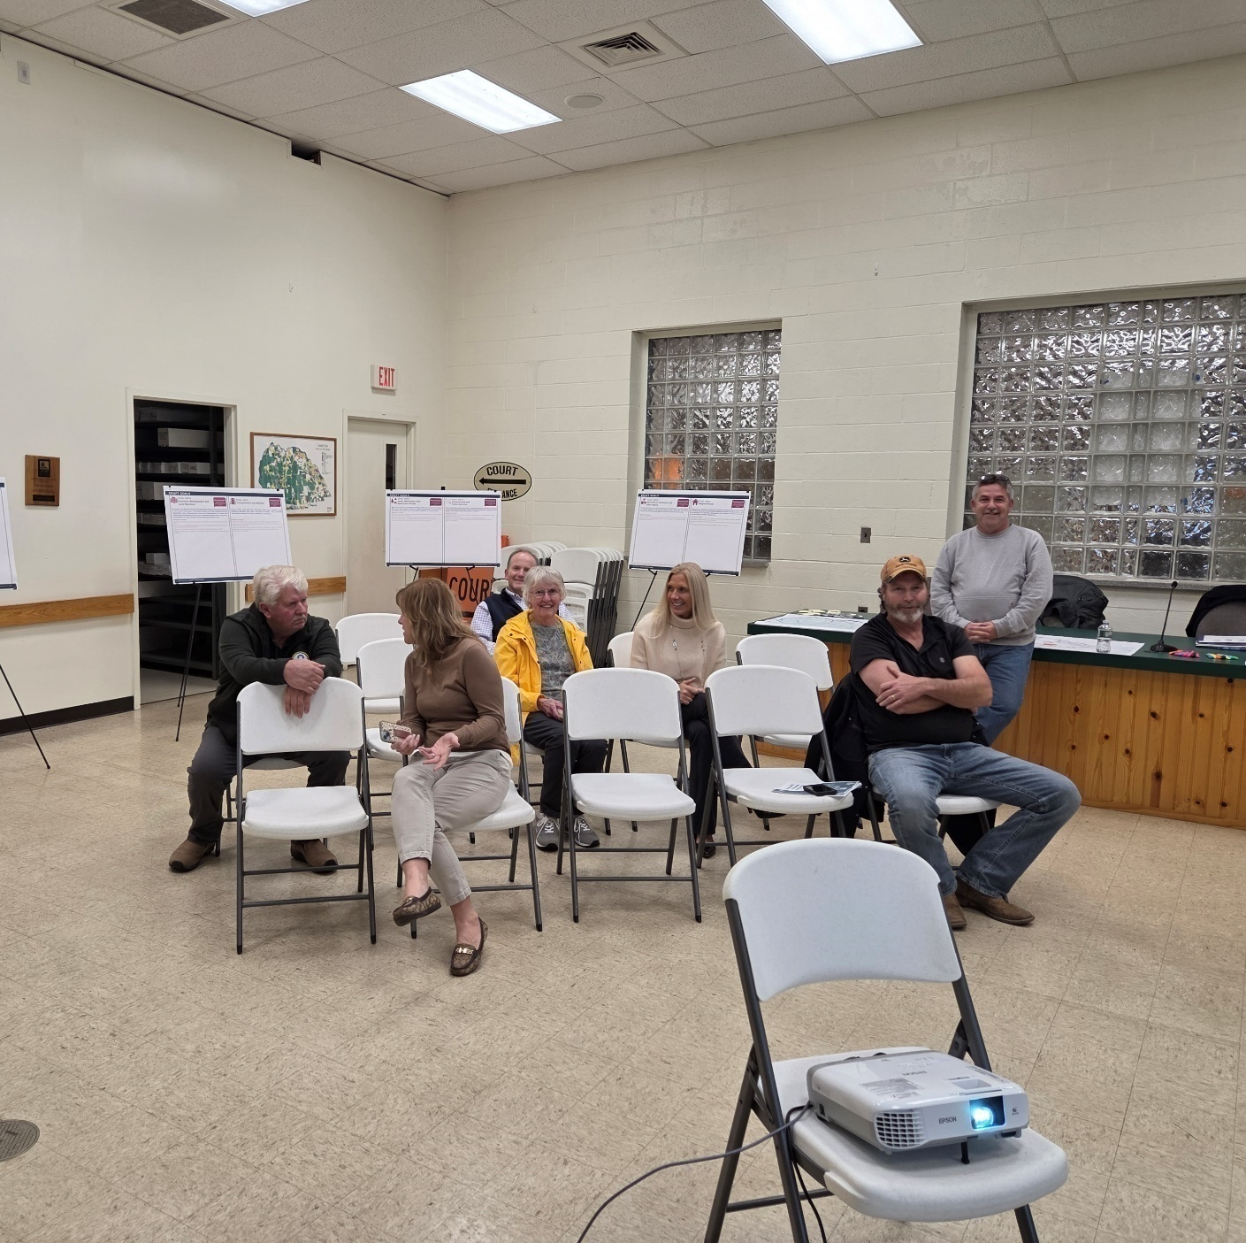
Workshop
Objectives & Project Feedback

Slide 29


Workshop Activity
8 Stations
Leave Comments
‘Invest’ in projects you support

Slide 30
Next Steps
Draft Comprehensive Plan
Committee Meeting #6
  Draft Plan Review
  Recommendation to Town Board
Town Board
  Begin SEQR Process

Slide 31
Project Schedule
We Are Here
Project kick-off
CPUC #2
CPUC #3
Workshop
CPUC
#4 & #5
Town Board Adoption
Workshop
CPUC #6
April 2025
June
Sept
Oct
Jan / Feb 2026
April
May
June
Community Profile
&
Previous Plans
Launch Community Survey
Visioning Workshop
Vision & Goals
Public Workshop
Objectives & Actions
Open House & Public Hearing
SEQR
Public Hearing #2
Draft Objectives & Actions
County Review
Final Comp Plan

Slide 32
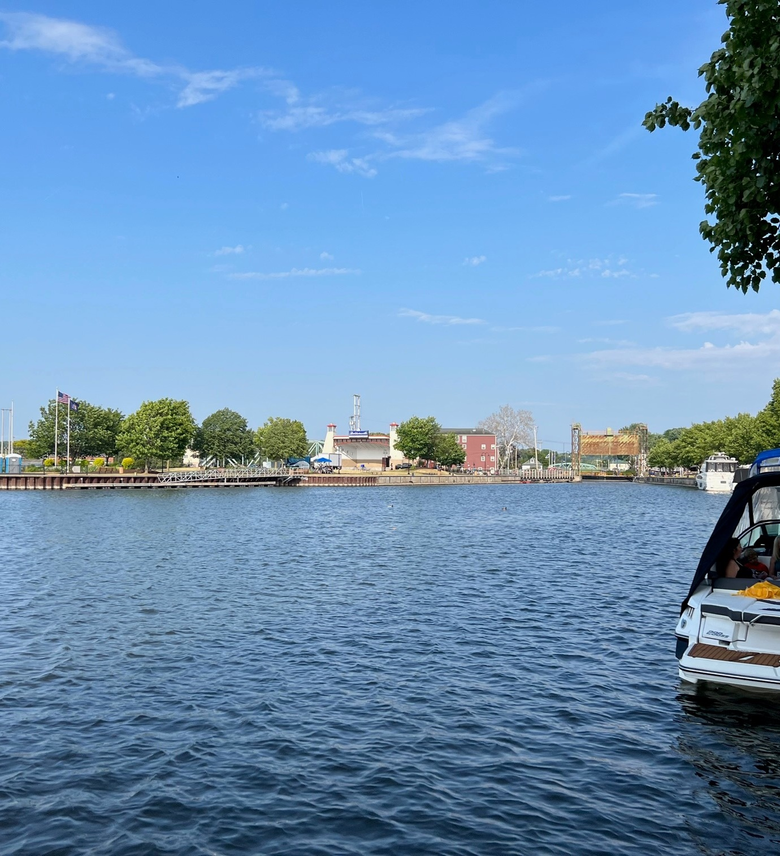

Thank you!
Follow the project website for updates!

Slide 33
Comparison of Community Mindsets
Transactional
Transformational
Budgeting & Taxes
Replacement of existing infrastructure in kind
Dotting the “I”s & crossing the “T”s during the administration of development proposals (SEQR)
Engineering comments (Drainage, Traffic)
Legal Issues
Budgeting & Taxes
Replacement of existing infrastructure in a manner that enhances the community
Using the development review process to protect or improve the community (SEQR)
Engineering Comments
Legal Issues
Community Character - Architectural comments
Community Priorities - Planner comments

